Slide 1
NSW Business Disaster
Support Forecasting
Team member
Wilma Liu (Leader)
Fiona Hu
Pat Zhang
Elvia Tong
Reehaa Ding
William Quan

Slide 2


TABLE OF CONTENT
Support from NSW government
Business disaster background
Areas where support are needed
Support measurement
Recommendations for future support
The serious impact of crisis

Slide 3
TABLE OF CONTENT
Support from NSW government
Business disaster background
Areas where support are needed
Support measurement
Recommendations for future support
The serious impact of crisis

Slide 4
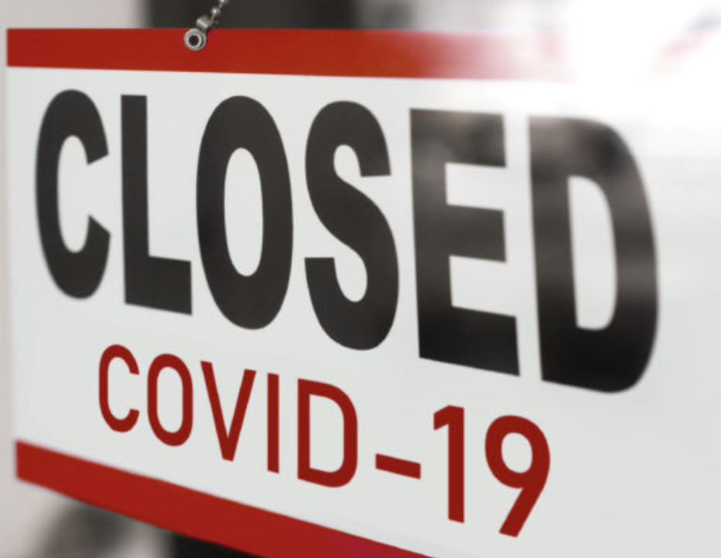
COVID19 - GLOBAL EPIDEMIC OUTBREAK
Differently from other epidemics, COVID-19 remains
the world’s deadliest epidemic
outbreaks.
It comes along with a systemic
global healthcare crisis, financial
crisis and economic downturn.

Slide 5
COVID19 IN NSW
23 June - Delta variant outbreak putting Greater Sydney, Blue Mountains, Central Coast, Wollongong and Shellharbour into lockdown
30 June - 5637 cumulative reported cases, including 56 deaths; 2.2 million vaccines administered
25 January - First COVID-19 case
1 June - Further restrictions eased
Post Jun 2021
Mar 2020
Feb 2021
Jan 2020
Jun 2020
Jun 2021
15 March - Special NSW Cabinet formed to combat COVID-19
20 March - Australia borders closed to non-residents
30 March - Gathering restrictions introduced
21 February - COVID-19 vaccinations started
11 October - Lockdown ended
1 November - International borders reopened for fully vaccinated
28 November - Omicron variant detected

Slide 6
AREAS WHERE SUPPORT ARE NEEDED IN NSW
Tourism
The main economic and employment source in Australia and NSW
To control the spread, government prohibited entry to borders, resulting in an immense hit for Australia and NSW tourism industry.
Business close
Many businesses closed during and after the lockdown
Business revenue decreased seriously during and after the lockdown
Different regions and industries have been impacted

Slide 7
TABLE OF CONTENT
Support from NSW government
Business disaster background
Areas where support are needed
Support measurement
Recommendations for future support
The serious impact of crisis
in tourism industry

Slide 8
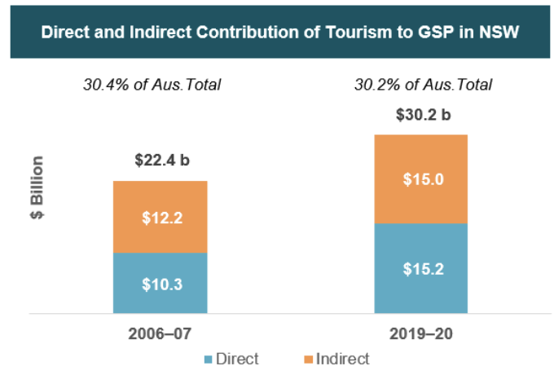
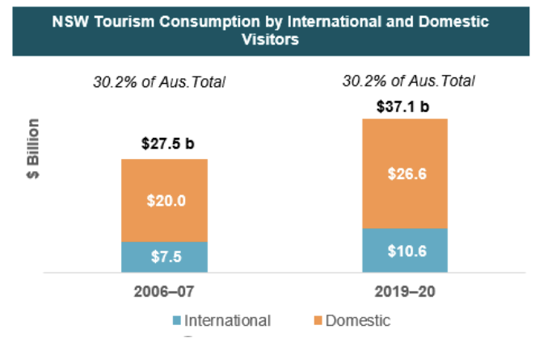
TOURISM IN NSW
The main economic source in Australia and NSW

Slide 9
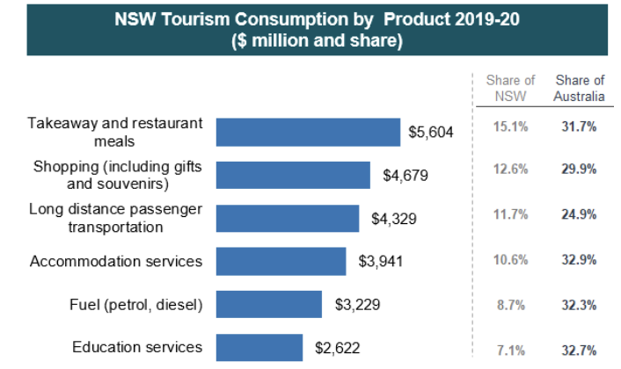
TOURISM IN NSW
The main economic source in Australia and NSW

Slide 10
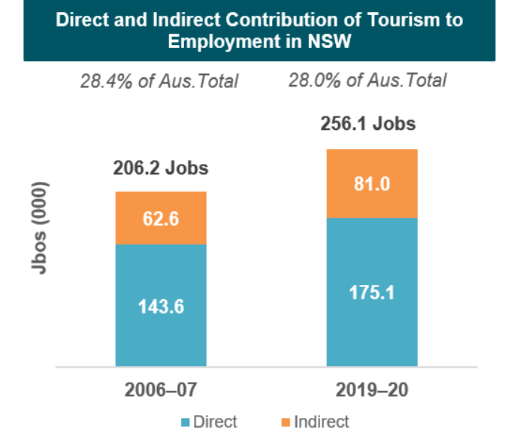
TOURISM IN NSW
The main employment source in Australia and NSW

Slide 11
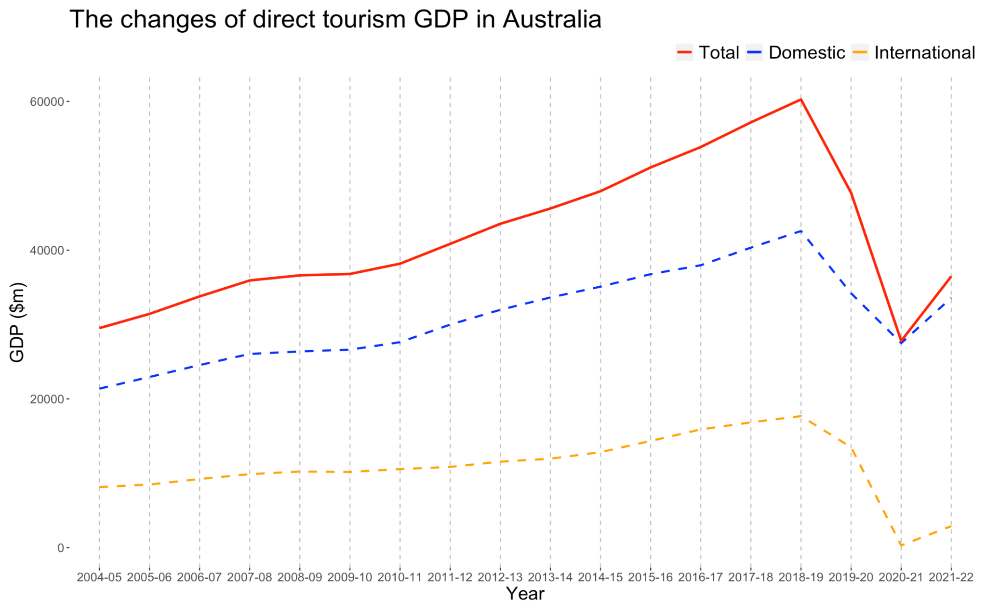
THE SERIOUS IMPACT OF CRISIS IN TOURISM

Slide 12
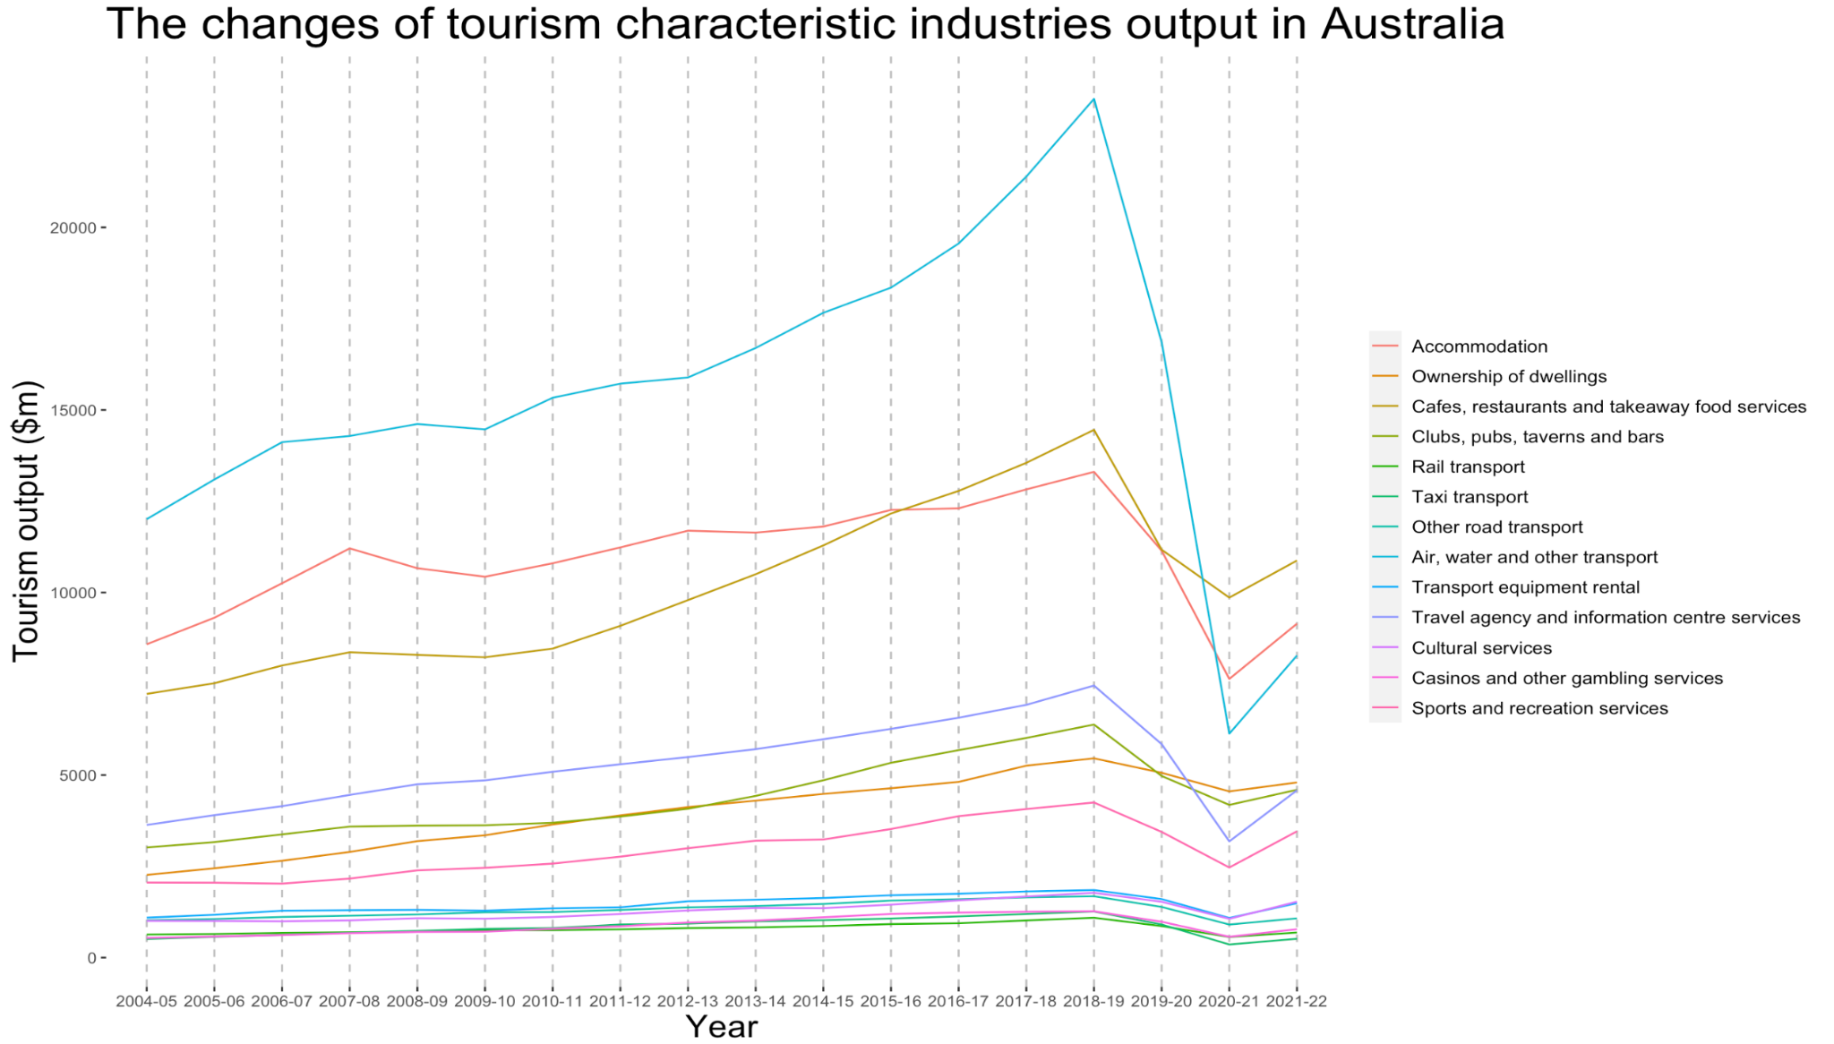
THE SERIOUS IMPACT OF CRISIS IN TOURISM

Slide 13
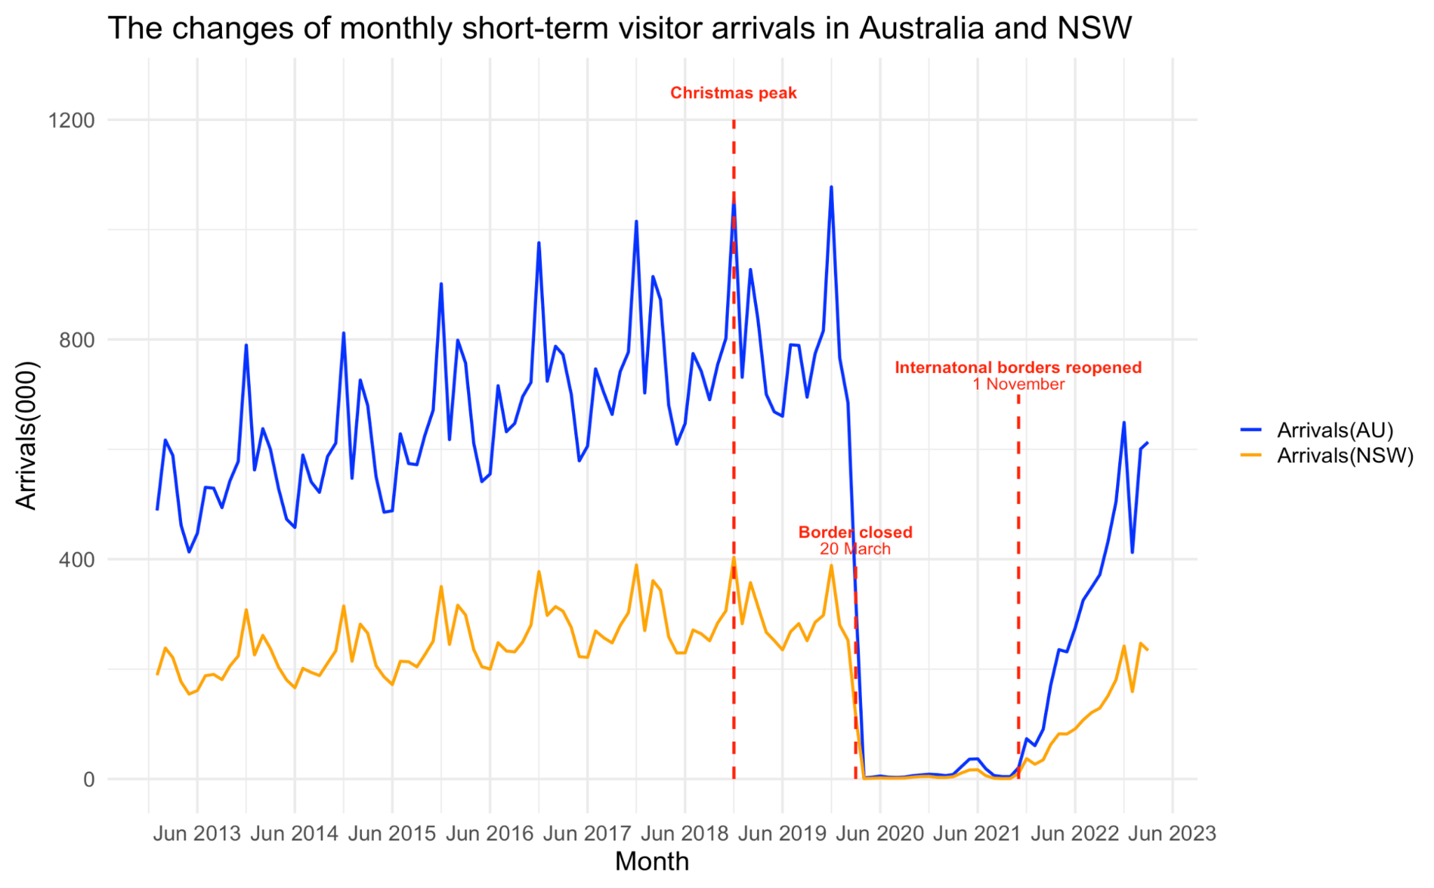
THE SERIOUS IMPACT OF CRISIS IN TOURISM

Slide 14
COVID-19 IMPACT PREDICTION IN TOURISM
Why is important to predict the impact of COVID-19 pandemic on the tourism industry?
From a business perspective
Build and implement effective decision-making frameworks
Ensure rapid responses to unanticipated events that threaten the financial sustainability
From a policy-making policy
Provide a better picture of tourism industry under the best case, worst case and in-between condition
Make the best decisions that mitigate the effect of upcoming epidemic outbreaks on the entire economy

Slide 15
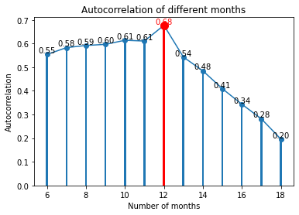
COVID-19 IMPACT PREDICTION IN TOURISM
Why do we use 12 step time series for forecasting?

Slide 16
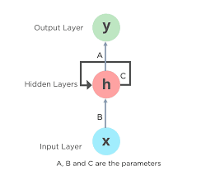
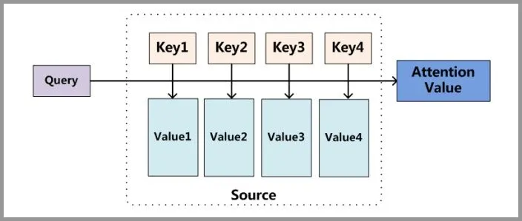
COVID-19 IMPACT PREDICTION IN TOURISM
 | Baseline | Improved
Model | Long-Short Term Memory | Transformer
Principle | Recurrent neural network | The Attention Mechanism
Advantage | Capture Long-Term Dependencies Sequential Computation | Capture Global Dependencies Parallel Computation

Slide 17
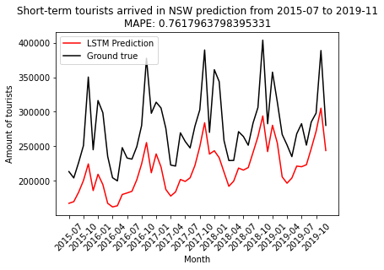
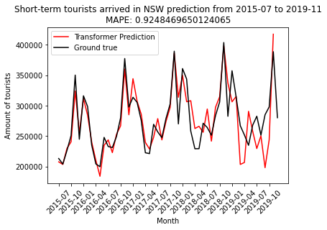
Performance comparison of the two models
Baseline Improved
The Transformer model has a higher accuracy

Slide 18
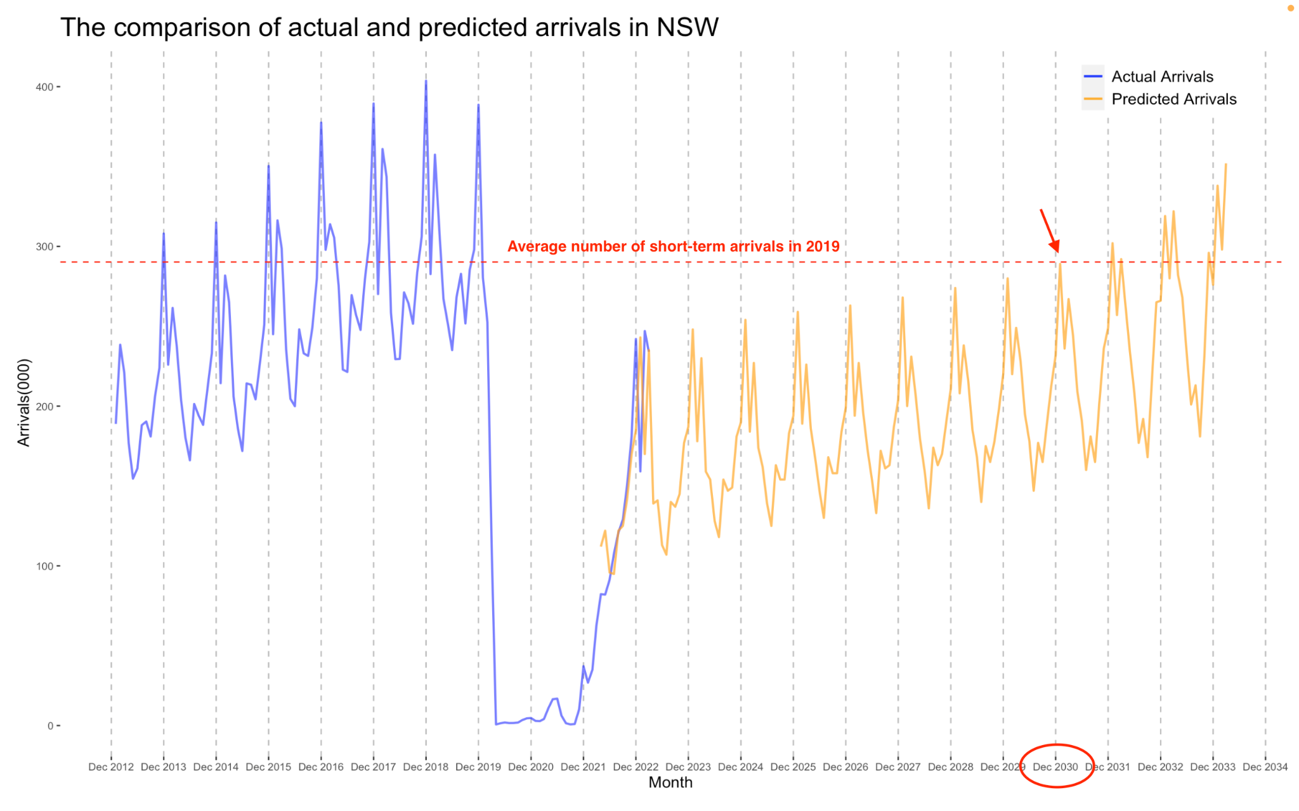
COVID-19 IMPACT PREDICTION IN TOURISM

Slide 19
TABLE OF CONTENT
Tourism support from NSW government
Business disaster background
Support measurement
in tourism industry
Areas where support are needed
Recommendations for future support
The serious impact of crisis

Slide 20
TOURISM SUPPORT FROM NSW GOVERNMENT
Regional Tourism Activation Fund
Accelerating the development of new and enhanced tourism infrastructure across regional NSW.
Round One
Provided almost $30 million in funding to over 30 projects that support the development of high impact tourism infrastructure and improve the accessibility of visitor experiences across regional NSW
Round Two
Committed $150 million to Round 2 that will increase the international appeal of destinations and boost the visitor economy through increased visitation and job creation
Round Three
More information will be made available later in 2023
Support source：https://www.nsw.gov.au/regional-nsw/programs-and-grants/regional-growth-fund/regional-tourism-activation-fund#:~:text=The%20NSW%20Government%20has%20committed,for%20local%20and%20international%20visitors.

Slide 21
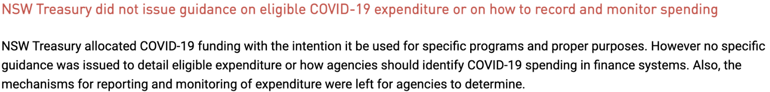
TOURISM SUPPORT MEASUREMENT
Obstacle
Lack of detailed periodic measure data about tourism industry
Unable to measure the tourism support effectiveness in NSW directly
Source: https://www.audit.nsw.gov.au/our-work/reports/covid-19-response-recovery-and-impact
Solution
Refer to COVID19 recovery methods from other countries that had obvious epidemic prevention effects, indirectly verifying effectiveness
Raised possible support recommendations through combining the NSW condition in different stages

Slide 22
TABLE OF CONTENT
Support from NSW government
Business disaster background
Areas where support are needed
Support measurement
Recommendations for future support
in tourism industry
The serious impact of crisis

Slide 23
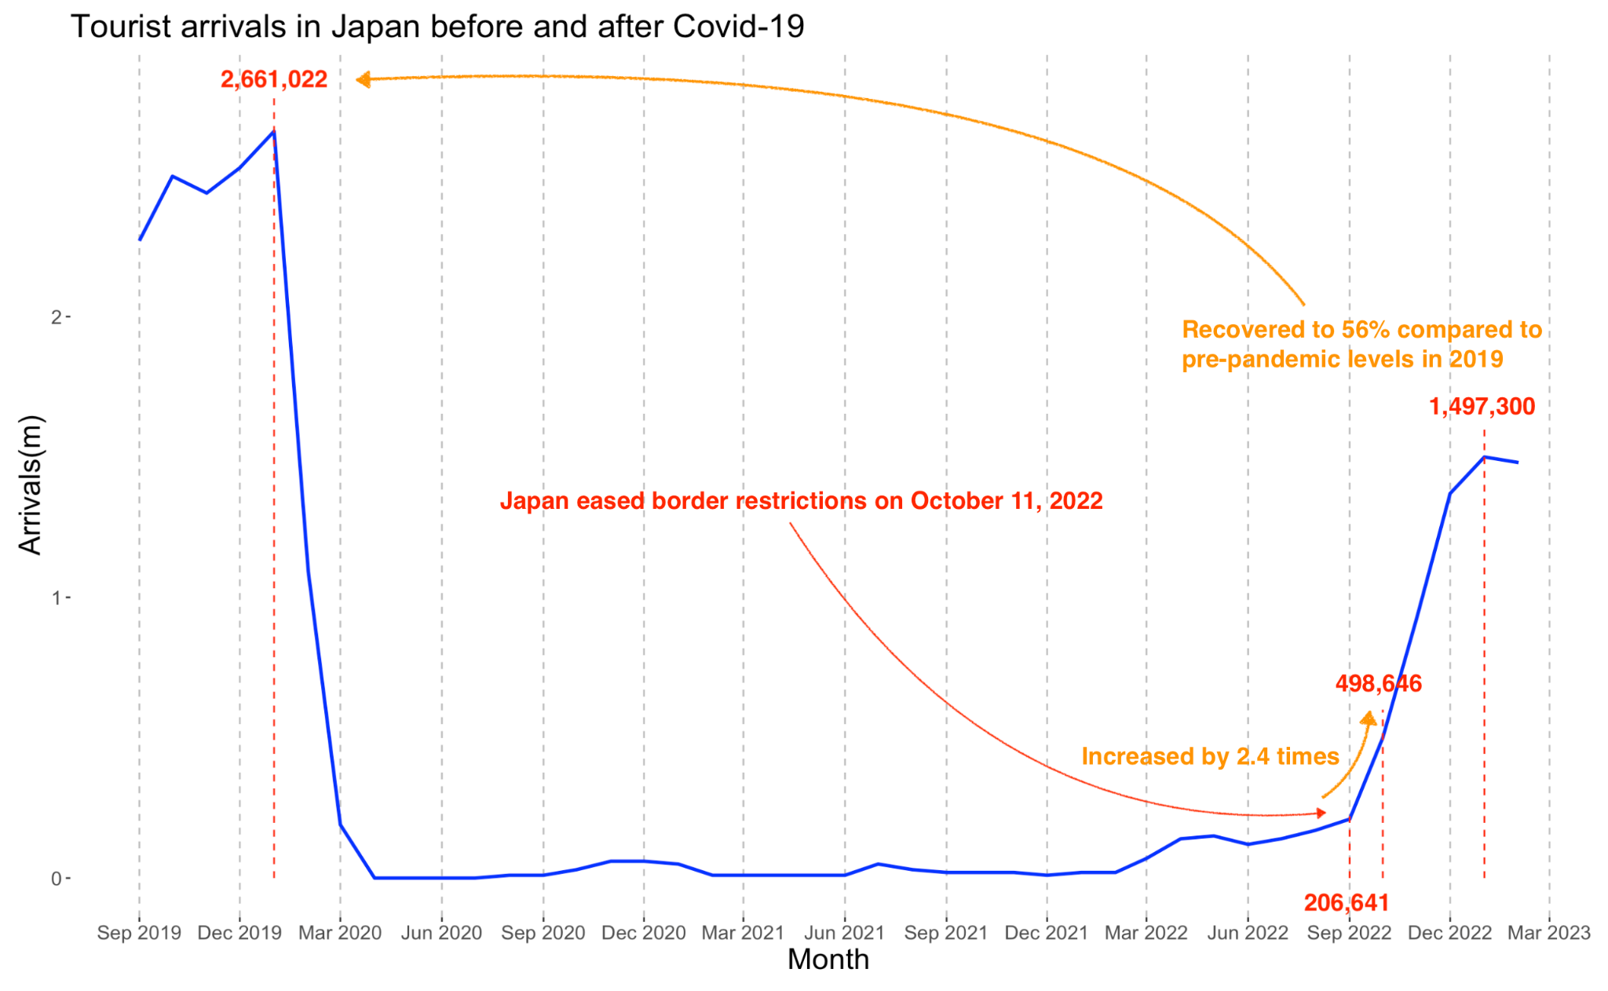
REFER TO RECOVERY METHODS FROM JAPAN

Slide 24
REFER TO RECOVERY METHODS FROM JAPAN
Recovery
Japan is expected to have 21.1 million international tourists this year, representing a year-on-year growth of 551%.
The number of tourists will recover to 66% of the pre-pandemic level this year, and plan to fully recover by 2025.
Support
Provide project financial aid, including facility renovation subsidy to provide value-added assistance of up to 100 million yen and tourist facility renovation subsidy of up to 10 million yen
Give subsidies worth 100 million yen for building conversion in tourism areas and grants of up to 20 million yen for the use of digital technology in tourism areas
Visit campaign: provide 40% discounts for accommodation and transportation.

Slide 25
TOURISM SUPPORT RECOMMENDATIONS
Raised possible support recommendations through combining NSW condition in different stages
A new normal
Recovery to pre-crisis level after similar pandemic is difficult
Government should disseminate this message and assist industry to realize and response the emerging economy in strategic way
During the lockdown
Travel and contact restrictions have increased the use of the internet for work and social connection
Develop new business models and update online tourism experiences and marketing
Support new venture creation, create new jobs and alleviate downside of business closures

Slide 26
TOURISM SUPPORT RECOMMENDATIONS
Raised possible support recommendations through combining NSW condition in different stages
Activating immediate recovery after lockdown
Develop visiting friends and relatives market, addressing the social disconnect and tourism challenges
Release vouchers that encourage people to shop locally
Connect visitors to local activities including arts and music
Reduce the travel cost of international and domestic tourists such as half-price airfares, package tour
Invest more in infrastructure
Provide tourism training, increase the market demand of labor force
Attract more foreign tourism investment

Slide 27
TABLE OF CONTENT
Small businesses grant from NSW government
Business disaster background
Support Success Measurement
for small businesses
Areas where support are needed
The serious impact of crisis on the business
Recommendations for future support

Slide 28
AREAS WHERE SUPPORT ARE NEEDED IN NSW
Tourism
The main economic and employment source in Australia and NSW
To limit the spread, government prohibited entry to borders, resulting in an immense hit for Australia and NSW tourism industry.
Business close
Many businesses closed during and after the lockdown
Business revenue decreased seriously during and after the lockdown
Different regions and industries have been impacted

Slide 29
Serious impact to the businesses
Restriction Timeline
23 March 2020-1 June 2020
18 July 2021-11 Oct 2021
Impact on all the businesses
Business exist and close in 20,21 lockdown
Average Revenue Impact to the businesses in 20,21 lockdown
Hypotheses on the Impact and support to the small businesses
Small businesses are serious impacted
By industries and regions
Business grant is important to ease this impact

Slide 30
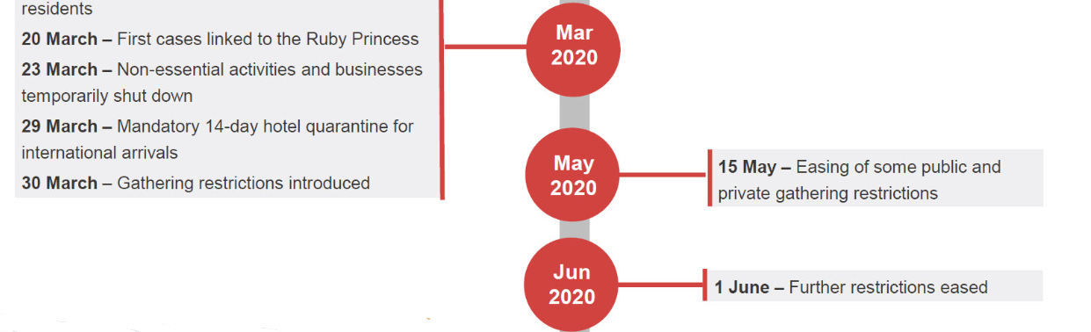
Restriction Timeline 23 March 2020-1 June 2020

Slide 31
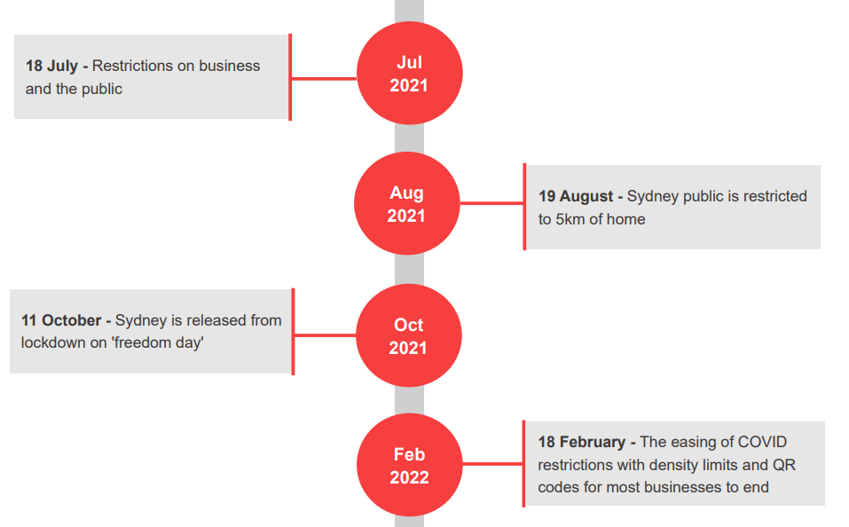
Restriction Timeline 18 July 2021-11 Oct 2021

Slide 32
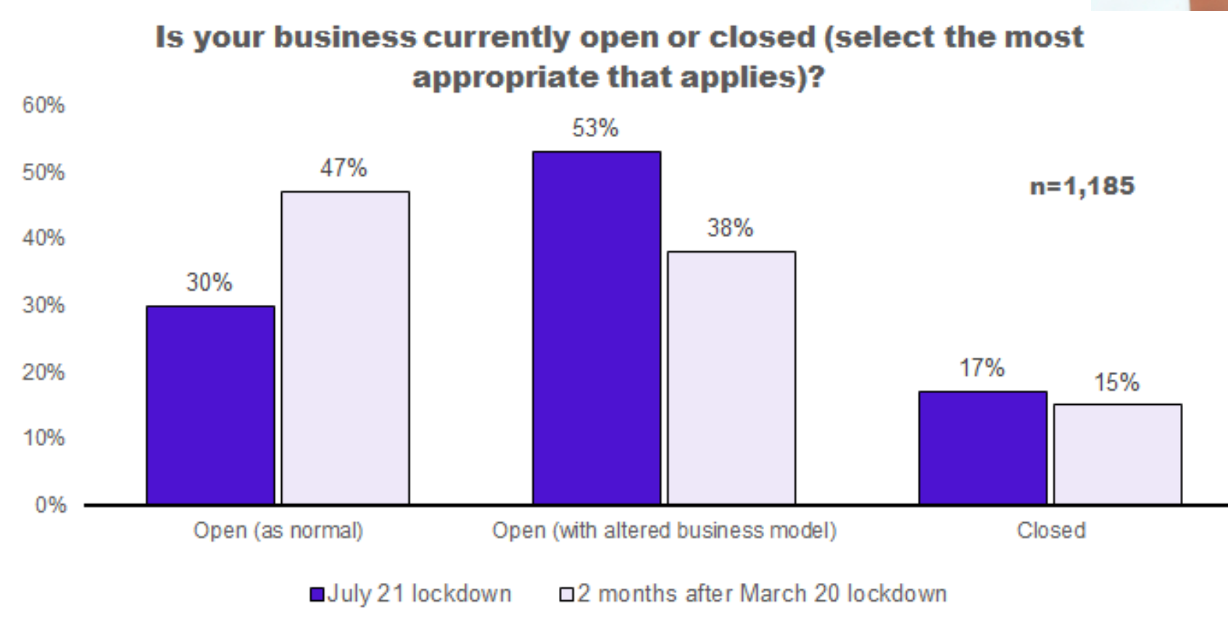
Serious impact to the businesses
- Business exist and close in 20,21 lockdown
Support source：https://www.businessnsw.com/content/dam/nswbc/businessnsw/surveys-other/COVID19%20BUSINESS%20IMPACTS%20SURVEY%20JULY%202021.pdf

Slide 33
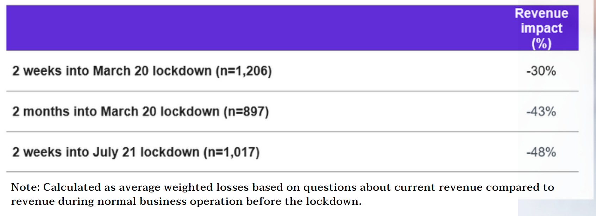
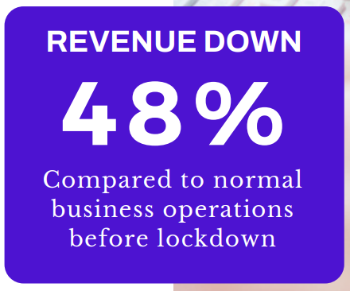
Serious impact to the businesses
- Average Revenue Impact to the businesses in 20,21 lockdown
Support source：https://www.businessnsw.com/content/dam/nswbc/businessnsw/surveys-other/COVID19%20BUSINESS%20IMPACTS%20SURVEY%20JULY%202021.pdf

Slide 34
Serious impact to small businesses
Data collected:
Source: Australian Bureau of Statistics
Collected annually on June 30 in 2020-2022
Counts of NSW businesses by each industry and region
Counts of NSW businesses from 2020-2022
Counts of NSW businesses by different turnover range
Assumptions to research on the hypothesis using data collected:
0-50k turnover range represents the small businesses(0-75k ×)
The businesses close all due to the effect of Covid-19

Slide 35
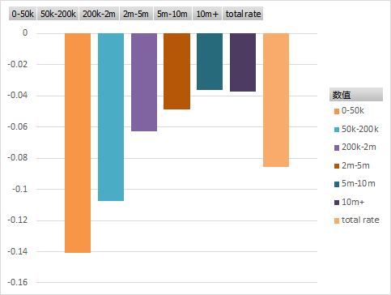
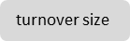
Serious impact to small businesses
The business change rate for the small business (0-50k) is the most
Support source：https://www.abs.gov.au/statistics/economy/business-indicators/counts-australian-businesses-including-entries-and-exits/latest-release
Small businesses are most likely to close

Slide 36
SMALL BUSINESS SUPPORT from NSW government
Support name | Date | Payment | Turnover
$10,000 small business support grant | 1 June 2020 | $520.8m | Less than 50k
$3,000 small business recovery grant | 1 July 2020 | $109.1m | Less than 50k
COVID-19 business grant | 19 July 2021 | $2.36b | Over 50k
COVID-19 micro-business grant | 26 July 2021 | $781.1m | Less than 50k
JobSaver payment | 26 July 2021 | $7.15b | Over 50k
2022 small business support grant | 16 February 2022 | $99.2m | Less than 50k

Slide 37
TABLE OF CONTENT
Small businesses grant from NSW government
Business disaster background
Support Success Measurement
for small businesses
Areas where support are needed
Recommendations for future support
Serious impact to the businesses

Slide 38
Support Success Measurement for small businesses
Assumptions
0-50k turnover range represents the small businesses
All the small businesses received small business grants
The data in the current year June represents the effect of the support applied during the last year June to the current year June
Business close rate (the counts of the businesses in the current year comparing to the last year) is used as the support success measurement criteria
The change of the business close rate are all contributed by the business grant support (not consider about the new entry and other exit reasons)
Method
Measure the support success using visualizations
The region clusters where have severe business close problems
The industries of these regions have

Slide 39
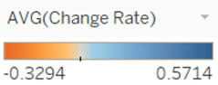
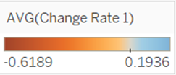
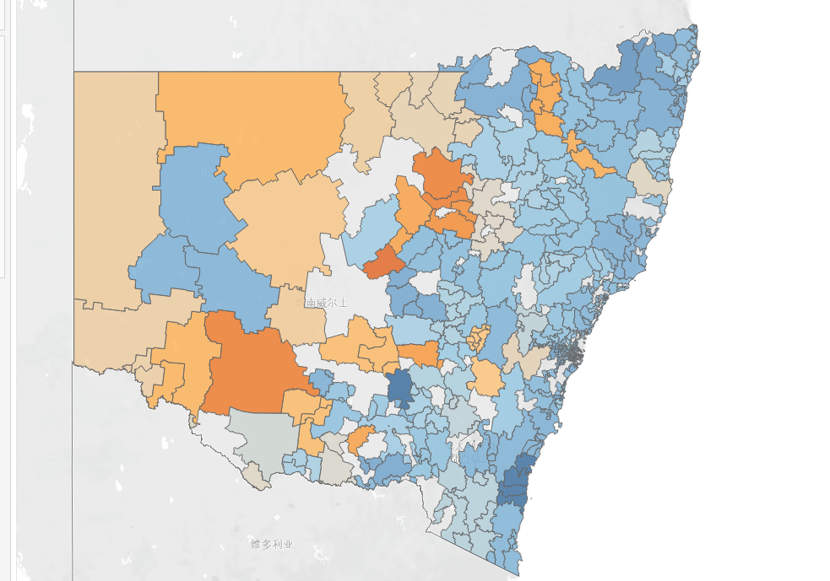
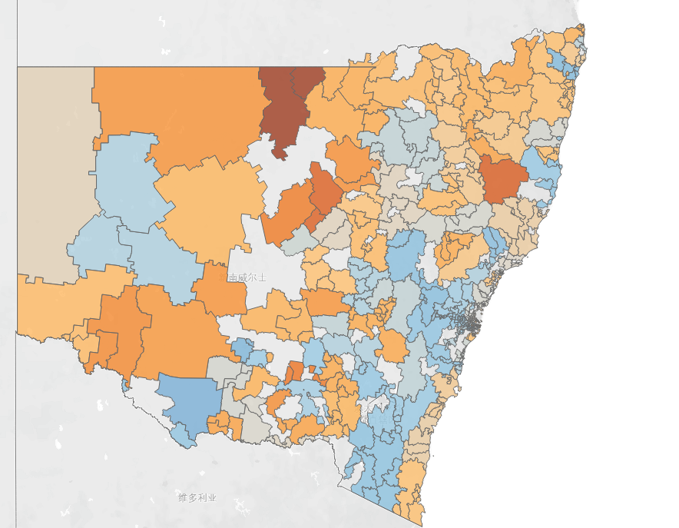
Support Success Measurement for small businesses
The regions clusters deteriorate in 2022 compared to 2021
Business close rate in 2021
Business close rate in 2022

Slide 40
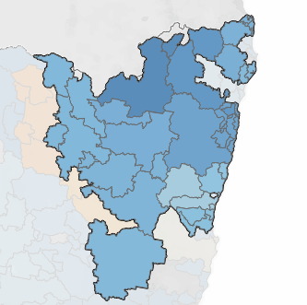
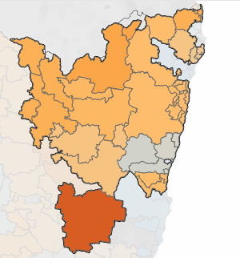
Support Success Measurement for small businesses
North East regions close rate by industries in 2021, 2022
Industry | Business close rate 2021 | Business close rate 2022
Mining | 0.189 | -0.481
Education and Training | 0.302 | -0.392
Utilities | 0.1 | -0.29
Wholesaling | 0.002 | -0.191

Slide 41
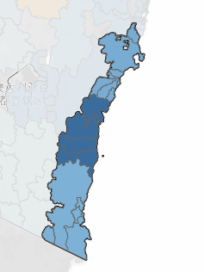
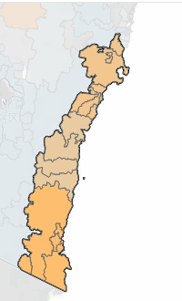
Support Success Measurement for small businesses
South East regions close rate by industries in 2021, 2022
Industry | Business close rate 2021 | Business close rate 2022
Mining | -0.125 | -0.5
Transport | -0.005 | -0.25
Education and Training | 1.671 | -0.212
Utilities | 0.333 | -0.2

Slide 42
Support Success Measurement for small businesses conclusion
The support (2022 small business support grant) is not effective to the North East and the South East seaside regions.
For the North East regions, the industries Mining, Education and Training, Utilities and Wholesaling needs more effective supports.
For the South East seaside regions, the industries Mining, Transport, Education and Training, and Utilities needs more effective supports.

Slide 43
Limitations
BA/ DA analysis are strictly relying on the assumptions using the ABS business close data
0-75k turnover range represents the small businesses- The true turnover range of small business is from 0-50k, but the collected by ABS only has the range 0-75k
All the small businesses received small business grants- cannot tell who get the grants on the data
The change of the business close rate are all contributed by the business grant support- Not consider about the new entry and other exit reasons)
The data in the current year June represents the effect of the support applied during the last year June to the current year June- Annually data only tell the overall variation across years
Business close rate (the counts of the businesses in the current year comparing to the last year) is used as the support success measurement criteria- Need more persuasive criteria to measure the success

Slide 44
TABLE OF CONTENT
Small businesses grant from NSW government
Business disaster background
Support Success Measurement
for small businesses
Areas where support are needed
Recommendations
Serious impact to the businesses

Slide 45
Recommendations
BA/ DA analysis method using visualizations
Measure the success of the support in different regions and industries
Data collection strategy
Enable the forecast and improve the BA/ DA analysis
Forecast method
Foresee the future support success, then apply the BA/DA analysis method
Automated visualization generalization method
Automate the visualization process of the BA/DA analysis

Slide 46
Recommendation
Data collection strategy- Collect the data in more frequent basis
Solve this assumption: The data in the current year June represents the effect of the support applied during the last year June to the current year June- Annually data only tell the overall variation across years
Narrow down the impact date range when using the BA/DA analysis to measure the success of the support across different time slots- For example, collect every two weeks to show the monthly effect of the support.

Slide 47
Support Success Measurement for small businesses
Imagine if we could foresee this in 2021

Slide 48
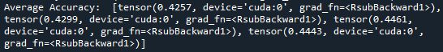
Recommendation
Data collection strategy- Collect the data in more frequent basis
Collect the data in more frequent basis could give more time slots, which enables the forecast model building like the tourism have done.
Poor performance model built in W8- 42% prediction accuracy
Only have 2018-2022 annually data (5 time slots), Time series forecasting need at least 25 time slots

Slide 49
Recommendations
Forecast method can enable:
Measure the success of the current support’s success in the following future
Measure the impact of the problems (business close) in the following future, similar as the tourism problem
If we could forecast the number of businesses are going to close for specific regions and industries, the government could tailor the support program for these specific regions and industries.

Slide 50
Recommendations
Assumptions and limitations
The forecast model like Transformer could capture the patterns from the past data, but we assume there is not a particular event cannot be forecasted using the training data (COVID).
For example, if there is an economy crisis in the future…
Deep learning forecast model is just a statistical inference, not causal inference.
For example, if we forecast a specific region’s business which received the grants but close in the following month, we could say there might be some relationship between the business close and the business grant, but the business grant does not have a causal effect on the business close.

Slide 51
Recommendations
Automated visualization generalization method
A Python based programmed algorithm to generate the automated visualizations for the support success measurement in the BA/DA analysis.

Slide 52
Recommendations
Automated visualization generalization method strength
Automate the process of the BA/DA analysis’s visualizations mentioned before
Quick, automated, and large number of visualization generation
Take the input data go as you need, real-time updated data

Slide 53
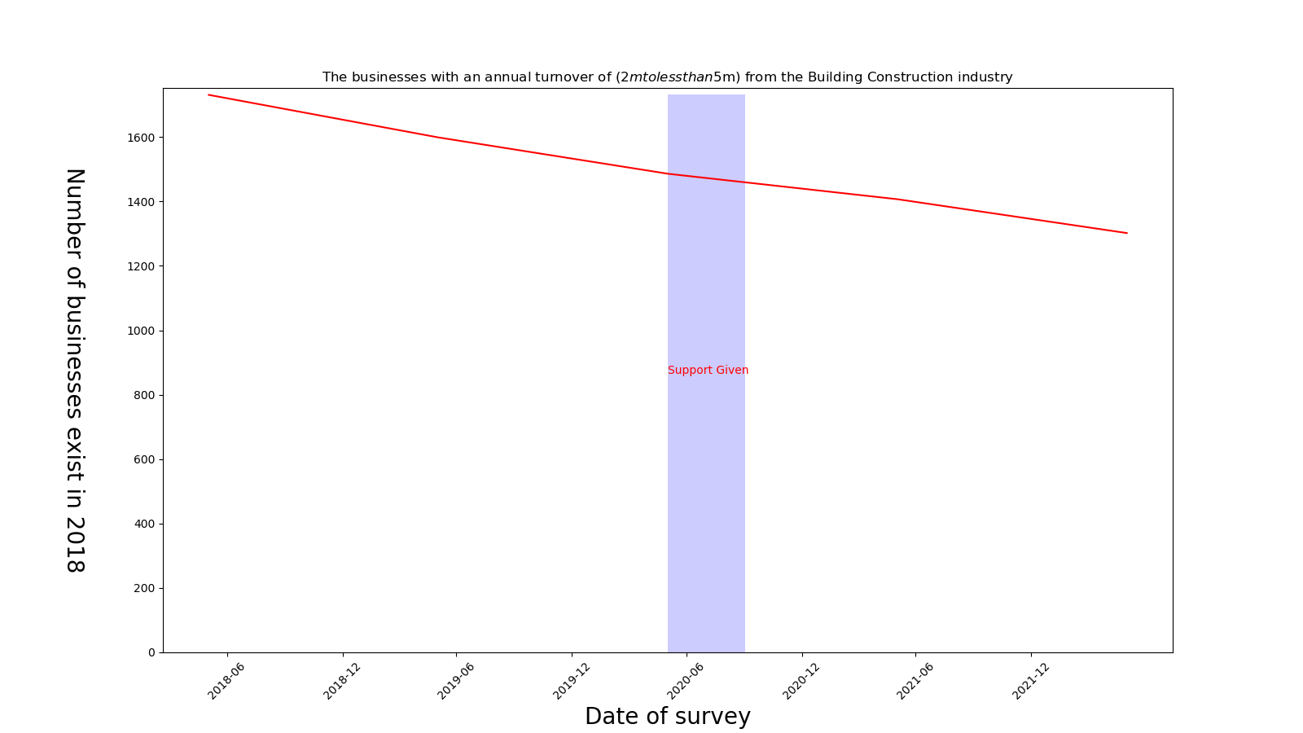
Recommendations- Example of one visualized chart
Automated visualization generalization method

Slide 54
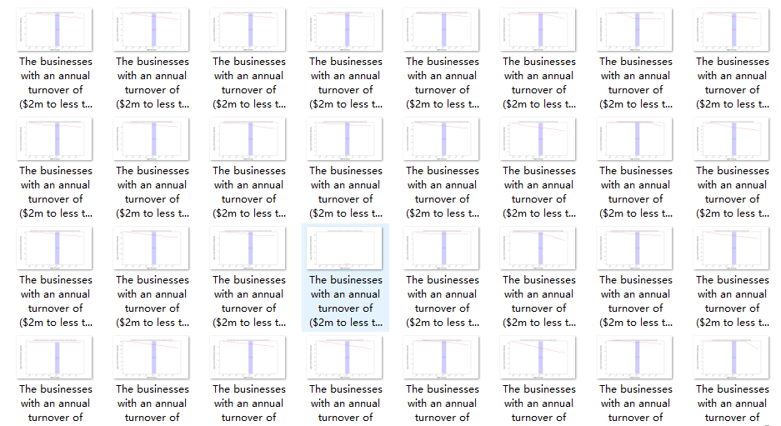
Recommendations-The overview of all outputs
Automated visualization generalization method

Slide 55
Recommendations
Automated visualization generalization method future work
The representation of the automated generated visualizations should be more aesthetic and intuitive for the audience.
The algorithm need to be updated to meet the requirements not be limited to the measurement of the business close support success by industries
A user-friendly interface needed to be designed as the algorithm in coding might be hard for the users to use and store the output

Slide 56

Thank you !!!

